Slide 1

Computer Processors
Boolean Arithmetic
Lecture 9

Slide 2
Boolean Arithmetics
Boolean Arithmetic is a fundamental building block for computers
We would like the operations
addition/subtraction/multiplication/division
Multiply by a power of 2
Divide by a power of 2
Square root

Slide 3
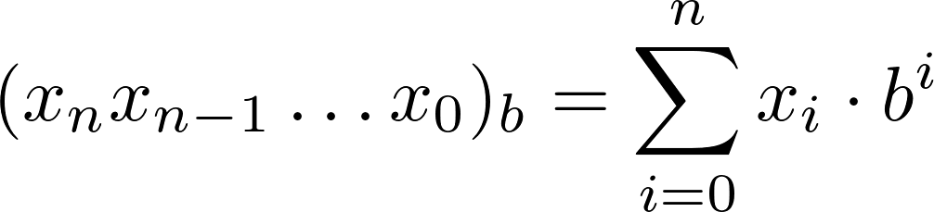
Numbers base b
Decimal numbers are base 10
Common bases in Computer Science
2 (Binary)
8 (Octal)
16 (Hexidecimal)

Slide 4
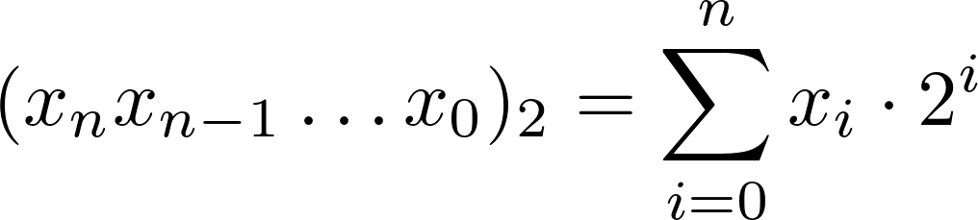
Binary numbers
Binary number are base 2
Example
What is the largest number that can be represented in 32-bit in base 2?

Slide 5
Binary addition
A pair of binary number can be added
x_{n} | y_{n} | Z_{n} carry to z_{n+1}
0 | 0 | 0 carry 0
0 | 1 | 1 carry 0
1 | 0 | 1 carry 0
1 | 1 | 0 carry 1

Slide 6
Binary addition example
x_{n} | y_{n} | Z_{n} carry to z_{n+1}
0 | 0 | 0 carry 0
0 | 1 | 1 carry 0
1 | 0 | 1 carry 0
1 | 1 | 0 carry 1
 | 2⁴ | 2³ | 2² | 2¹ | 2⁰
x | 0 | 0 | 1 | 1 | 1
y | 1 | 0 | 1 | 1 | 0
x+y
Carry

Slide 7
Binary addition example
x_{n} | y_{n} | Z_{n} carry to z_{n+1}
0 | 0 | 0 carry 0
0 | 1 | 1 carry 0
1 | 0 | 1 carry 0
1 | 1 | 0 carry 1
 | 2⁴ | 2³ | 2² | 2¹ | 2⁰
x | 0 | 0 | 1 | 1 | 1
y | 1 | 0 | 1 | 1 | 0
x+y | 1 | 1 | 1 | 0 | 1
Carry | 0 | 1 | 1 | 0

Slide 8
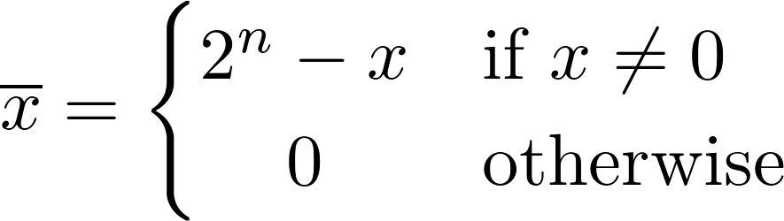
Signed binary number
A binary number system with n digit can represent a set of 2^{n} different numbers
To represent negative numbers we use Signed binary numbers
Split the set of bit pattern into two parts
2’s complement
Notes:
Two's complement is not a complicated scheme and is not well served by anything lengthly. Therefore, after this introduction, which explains what two's complement is and how to use it, there are mostly examples.
Two's complement is the way every computer I know of chooses to represent integers. To get the two's complement negative notation of an integer, you write out the number in binary. You then invert the digits, and add one to the result.
Suppose we're working with 8 bit quantities (for simplicity's sake) and suppose we want to find how -28 would be expressed in two's complement notation. First we write out 28 in binary form.
00011100
Then we invert the digits. 0 becomes 1, 1 becomes 0.
11100011
Then we add 1.
11100100
That is how one would write -28 in 8 bit binary.
How do we represent negative numbers using signed binary numbers, we can use the formaular – we will look at another example on this on the next slide
https://www.cs.cornell.edu/~tomf/notes/cps104/twoscomp.html

Slide 9


Signed Binary numbers example
In a 5-bit binary system, how do we represent -5?
Can we check this? Yes
Notes:
In a 5-binary system, 5 is represented as 00101. if we find the two’s complement of this: first change 00101 to 11010 and then add 1, we 11011 this is -5
Alternatively we can use the formular shown on the previous slide. 2 raise to power 5 minus 00101 will give us 11011. I will leave this with you.
https://u.osu.edu/storageofdata/signed-binary/#:~:text=Signed%20binary%20is%20very%20similar,0's%20and%200's%20to%201's.

Slide 10
Signed binary number
2’s complement can represent 2^{n} integers
Maximum and minimum values are 2^{n-1} -1 and -2^{n-1} (respectively)
All positive numbers start with 0
All negative numbers start with 1

Slide 11
Quiz - TopHat
What is the two's complement representation of -11 in a 6-bit binary system?
Notes:
The answer is 53. How? In 6-bit binary system, 11 is 001011. invert this to 110100 and then add 1 to get 110101 this is 53 if you can this to decimal

Slide 12
Binary subtraction example
x_{n} | y_{n} | Z_{n} carry to z_{n+1}
0 | 0 | 0 carry 0
0 | 1 | 1 carry 0
1 | 0 | 1 carry 0
1 | 1 | 0 carry 1
 | 2⁷ | 2⁶ | 2⁵ | 2⁴ | 2³ | 2² | 2¹ | 2⁰
x | 0 | 0 | 0 | 1 | 0 | 1 | 1 | 0
y | 0 | 0 | 0 | 0 | 0 | 1 | 1 | 1
!y
!y+1
x+(!y+1)
Carry

Slide 13
Adders in logic
x | y | carry in | sum | carry
0 | 0 | 0 | 0 | 0
0 | 1 | 0 | 1 | 0
1 | 0 | 0 | 1 | 0
1 | 1 | 0 | 0 | 1
0 | 0 | 1 | 1 | 0
0 | 1 | 1 | 0 | 1
1 | 0 | 1 | 0 | 1
1 | 1 | 1 | 1 | 1
Adding two bit’s together can be represented by a truth table
Adding two bit’s together can be computed by logic gates

Slide 14
Half-adder
Adding two bit’s together can be represented by a truth table
Adding two bit’s together can be computed by logic gates
This logic circuit is called a Half-adder
What about the carry in?
x | y | sum | carry
0 | 0 | 0 | 0
0 | 1 | 1 | 0
1 | 0 | 1 | 0
1 | 1 | 0 | 1

Slide 15
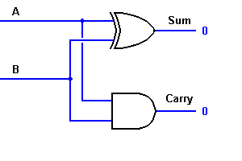
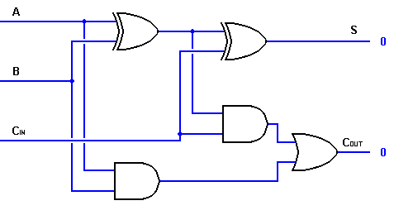
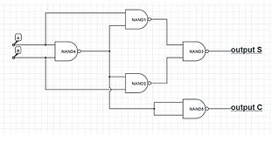
Poll: Which of these is a half adder?
A
B
C

Slide 16
Full-Adder
x | y | carry in | sum | carry
0 | 0 | 0 | 0 | 0
0 | 1 | 0 | 1 | 0
1 | 0 | 0 | 1 | 0
1 | 1 | 0 | 0 | 1
0 | 0 | 1 | 1 | 0
0 | 1 | 1 | 0 | 1
1 | 0 | 1 | 0 | 1
1 | 1 | 1 | 1 | 1
Adding 3 bits together can be seen as adding 2 bits together followed by adding the 3rd bit to the result
Adding 3 bits together can be achieved using two half-adders
This logic circuit is called a Full-Adder
What about adding more than single bits?

Slide 17
16-bit Adder
By cascading full-adders into each other we can achieve a multi-bit adder
No carry in for the first bit
Carry in for last bit is “lost”
This format of multi-bit add is called a ripple adder

Slide 18
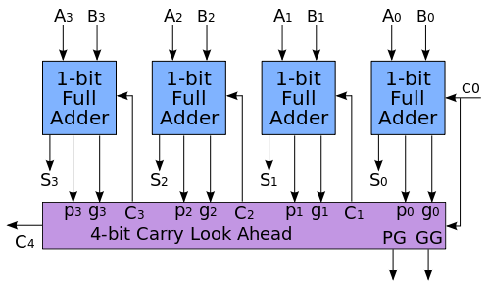
Carry-Look ahead adder
Some problems with ripple-adders can be overcome by carry-look ahead add
No more long propagation times
At the expense of simplicity
By en:User:Cburnett - Own workThis vector image was created with Inkscape., CC BY-SA 3.0, https://commons.wikimedia.org/w/index.php?curid=1477525

Slide 19
Summary
Introduced the concept of Boolean arithmetics
Recapped binary numbers
Recapped signed binary numbers and 2’s complement
Demonstrated half-adders and full-adders
Demonstrated multi-bit adders
Introduced look ahead adders
Interested in boolean arithmetics? Digital Systems Design Section 3.4-3.5

